Slide 1



AZURE DS & MLOPS DR. RAVI CHANGLE

Slide 2
AGENDA
MODULES
THE PLAN
CLOUD REQUIREMENTS

Slide 3

THE DATA SCIENCE
Module 1: Getting Started with Azure Machine Learning
Module 2: Visual Tools for Machine Learning
Module 3: Running Experiments and Training Models
Module 4: Working with Data
Module 5: Working with Compute

Slide 4

Engineering MLOps-I
Fundamentals of an MLOps Workflow
Characterizing Your Machine Learning Problem
Setting up the resources and tools .
Feature Store
Model Evaluation and Packaging
Production testing methods
Why package ML models?
How to package ML models

Slide 5
Engineering MLOps-II
Key Principles for Deploying Your ML System
Building Robust CI/CD Pipelines
APIs and Microservice Management
Testing and Securing Your ML Solution
Essentials of Production Release
Monitoring Machine Learning Models in Production
Model Serving and Monitoring
Governing the ML System for Continual Learning

Slide 6
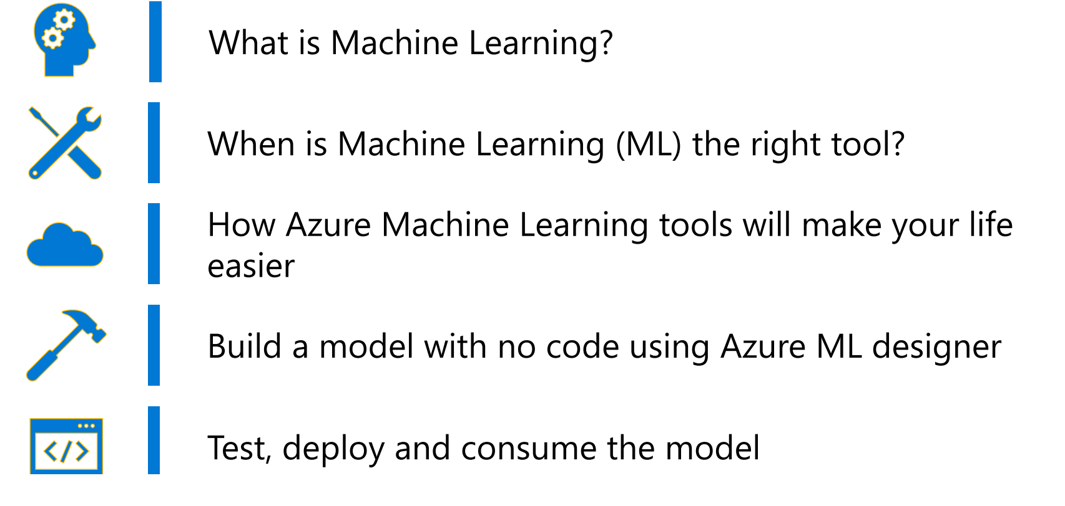

Slide 7
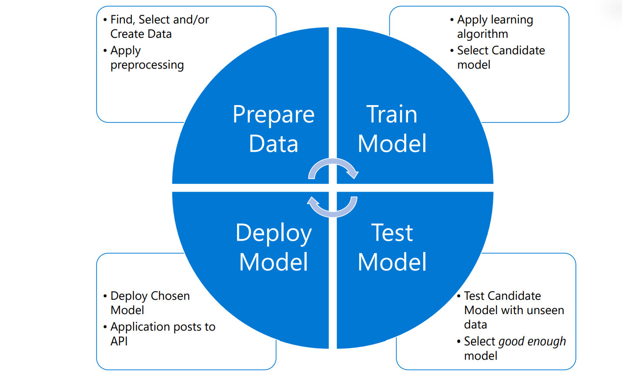

Slide 8
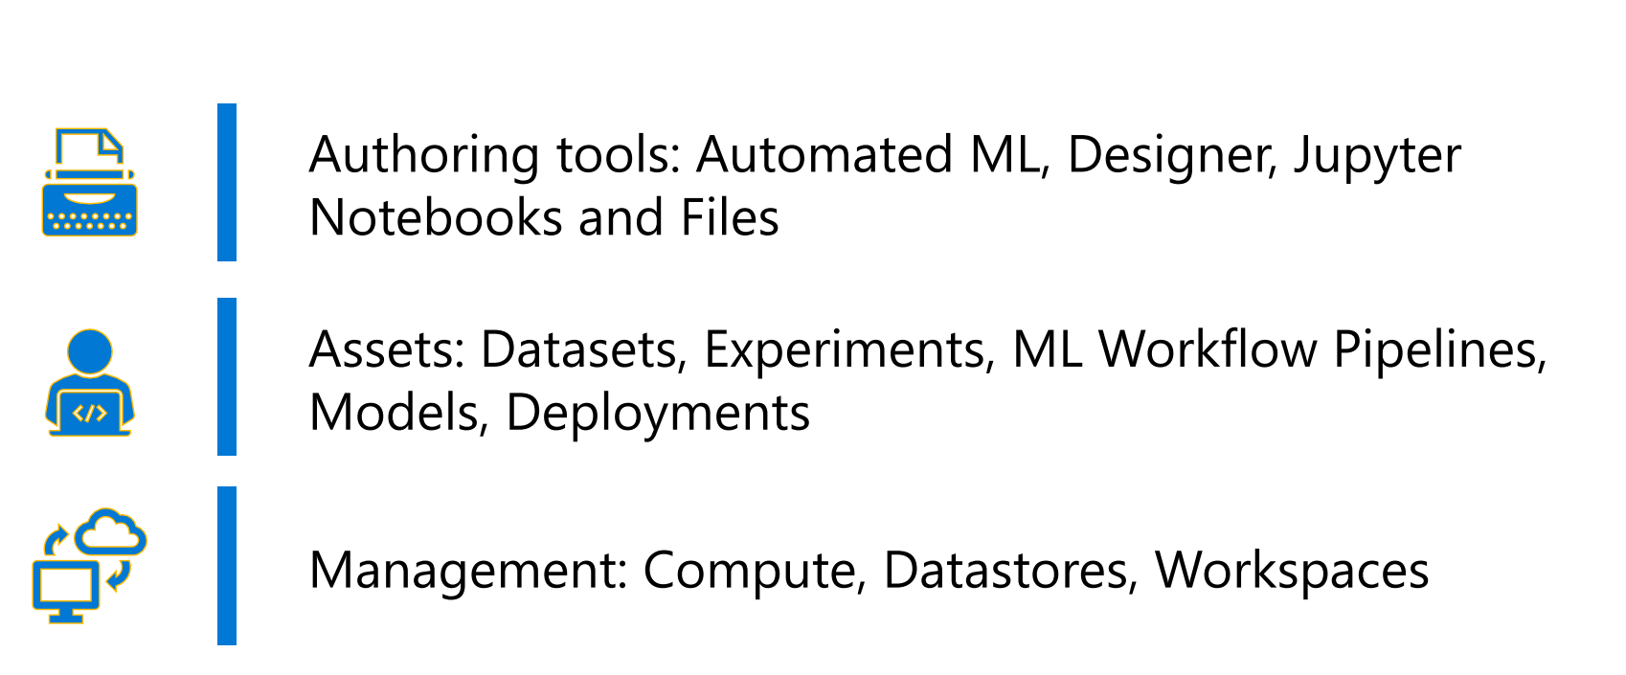

Slide 9
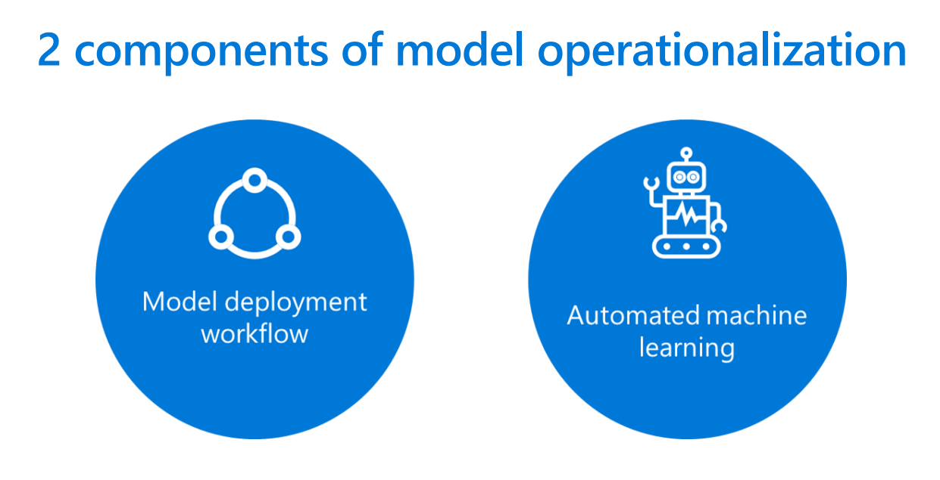

Slide 10
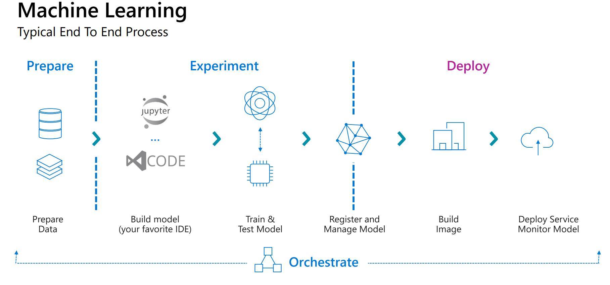

Slide 11
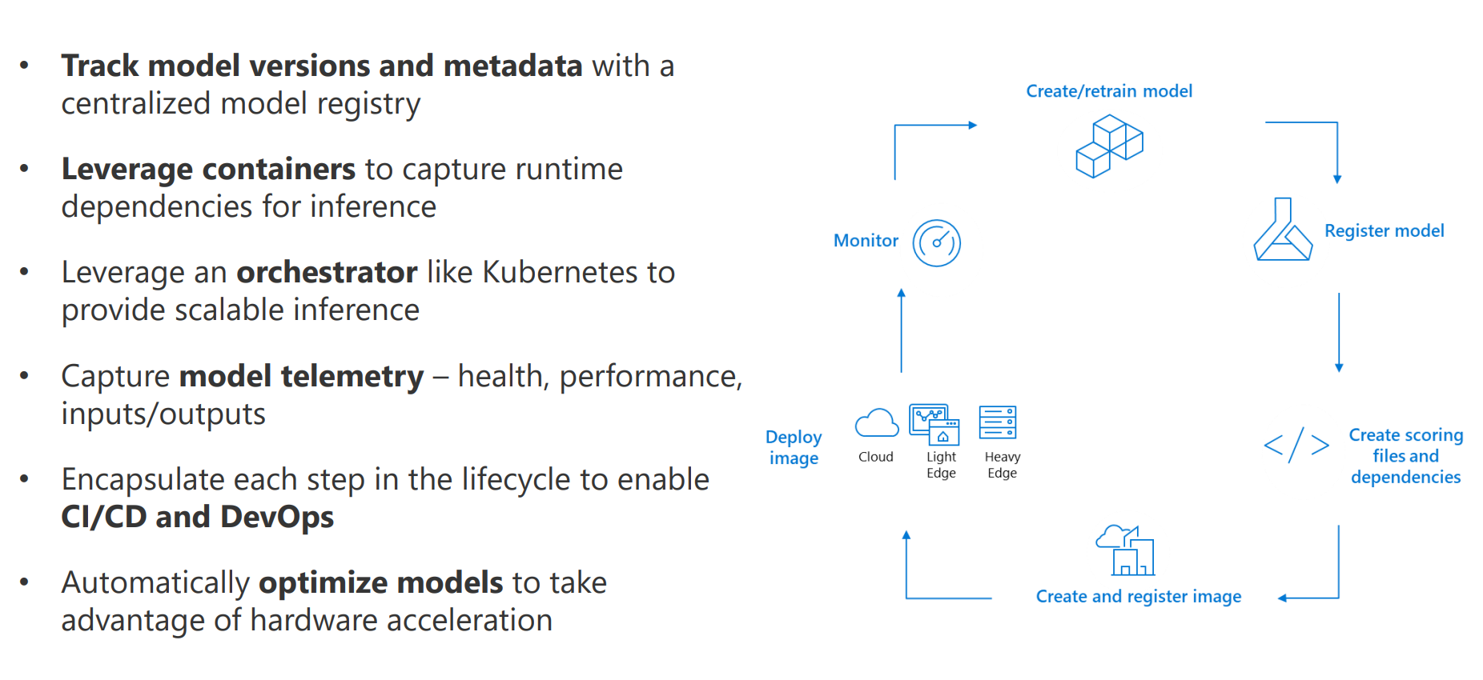

Slide 12
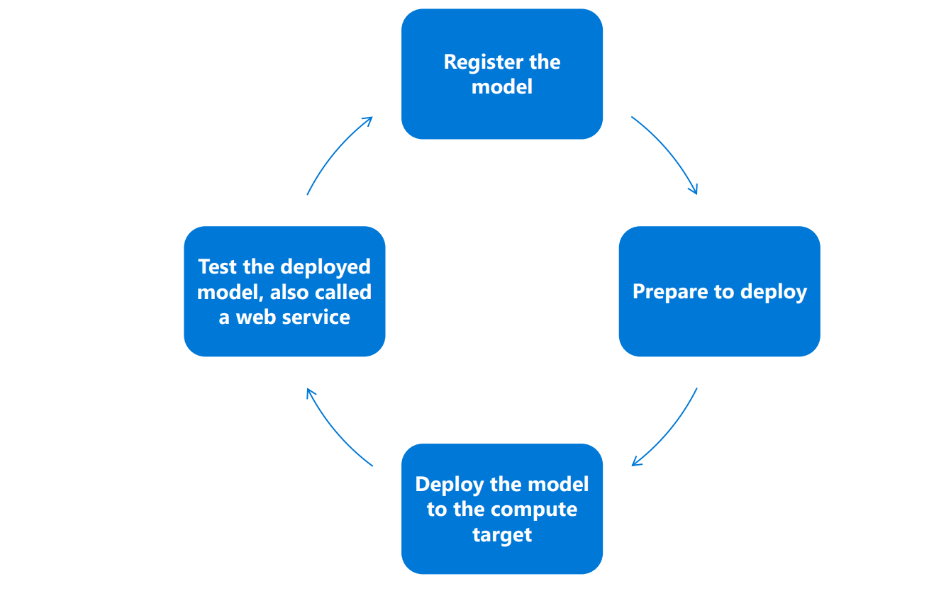

Slide 13
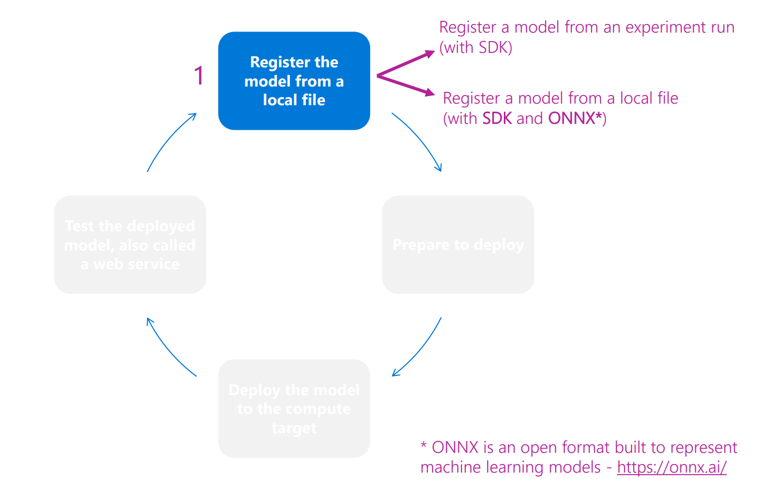

Slide 14
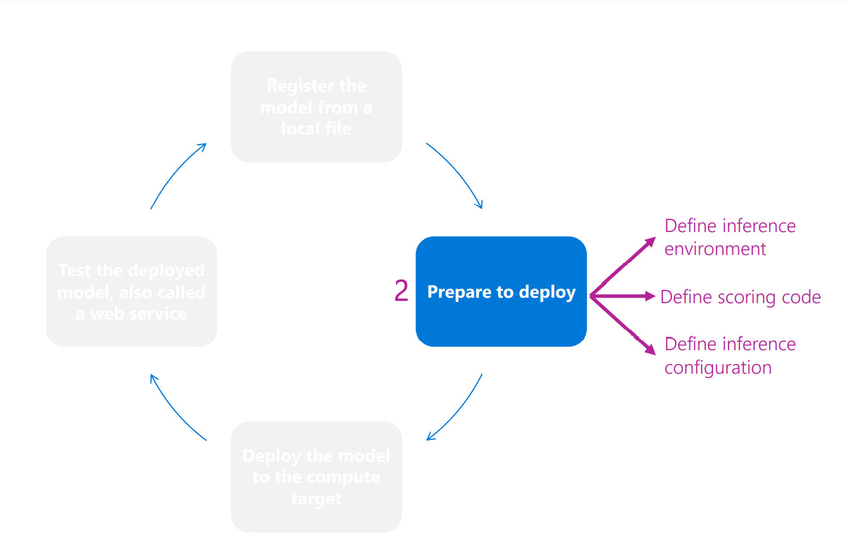

Slide 15
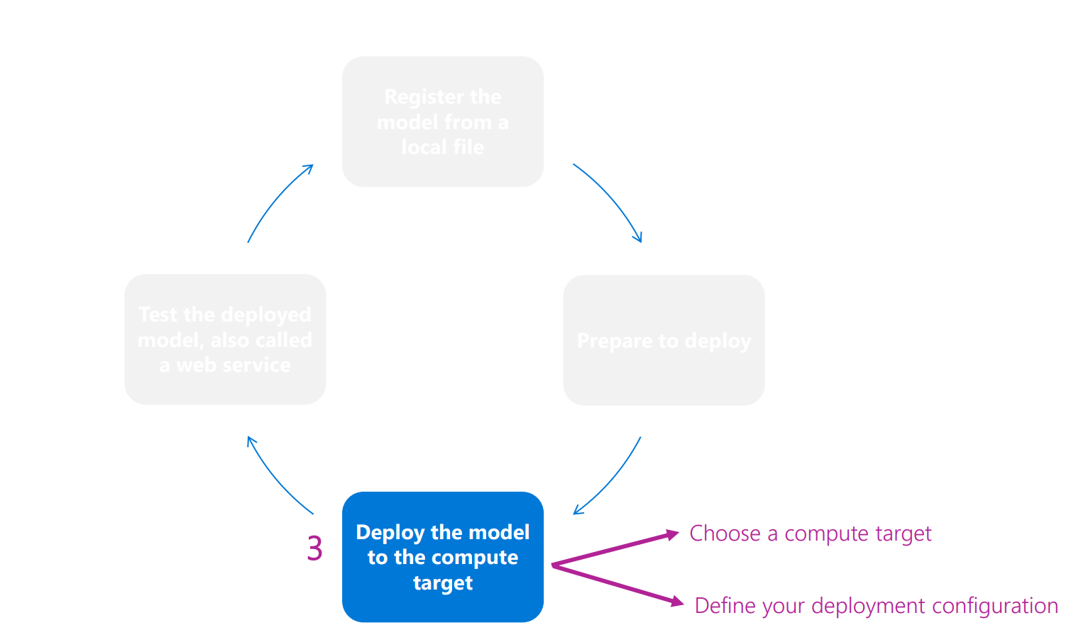

Slide 16
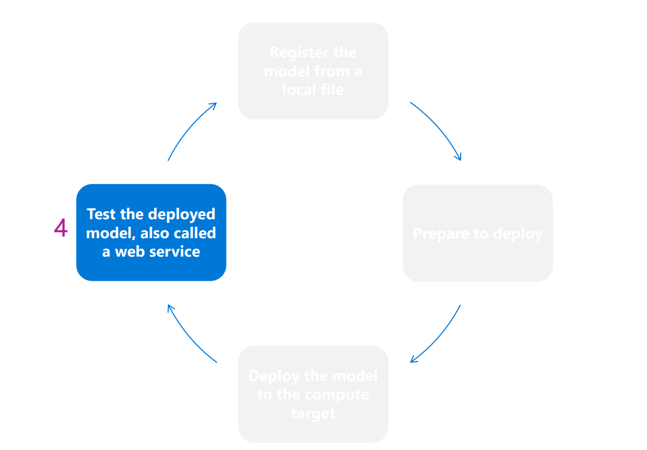

Slide 17

THANK YOU

